Slide 1
AIML CA2 Time Series
Air Pollution Forecasting
Name: Soh Hong Yu
Admin No: P2100775
Class: DAAA/FT/2A/01

Slide 2
Background Information
With Climate Change worsening day by day, we need to be wary of the causes of this problem. One such cause is the amount of air pollution in the world. We need to make predictions on how much air pollution we make. This will allow for regulations and laws to be set in place to prevent the amount of air pollution in the air.
The dataset seems to be derived from a Air Quality dataset found in UCI Machine Learning Repository, with some of the values in this dataset to match with the Air Quality dataset. Based on the dataset information, here we can assume that the data is curated using 4 metal oxide chemical sensors embedded in an Air Quality Chemical Multisensor Device. The device was located on the field in a significantly polluted area, at road level, within an Italian city.

Slide 3
TABLE OF CONTENTS
01
02
03
04
05
06
Data Exploration
Data Testing
Modelling
Exploratory Data Analysis
Run Time Series test
Time Series Models
Model Selection
Model Evaluation
Kaggle Score
Select best training models
Evaluation of models
Kaggle Submission

Slide 4
Data Exploration
01
Exploratory Data Analysis

Slide 5
Data Information
We will begin by conducting an exploratory data analysis of the data, to gain a better understanding of the characteristics of the dataset.
This is a dataset collected from a Air Quality dataset found in UCI Machine Learning Repository, it contains 1312 data points with 7 columns.
Date - date
T - temperature
RH - relative humidity
Gas - type of pollution gas
Value - amount of pollution

Slide 6
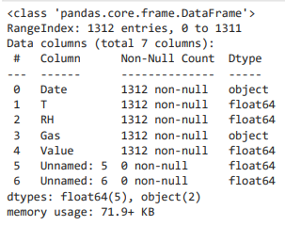
Data Information
Using pd.info(), we can make some observations.
The shape of dataset is (1312, 7) whereby there is 1312 observations and 7 columns. (4 Features + 1 Target Variable: "Value" + 2 Useless Variable)
Datatype of all columns are numeric except Date and Gas
There is no missing values in the entire dataset.

Slide 7
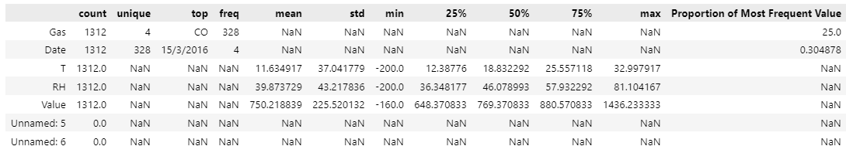
Data Information
Using the .describe(include=”all”) function, we are able to use it to find the proportion of values.
From looking at the most frequent value of each column, we note that:
All 4 Gases have equal amount of data points as proportion of most frequent value is 25%
T and RH are likely to be negatively skewed with many outliers as the min value of T and RH is much lower than the lower quartile

Slide 8
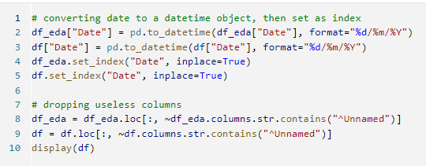
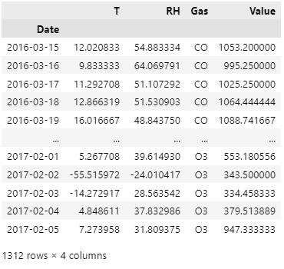
Editing Date and Removing Columns

Slide 9
Pandas Profiling
Pandas Profiling is a convenient tool to quickly explore datasets. We will be using it to get some summaries and will be using numpy and pandas functions to replicate the points.
Summary:
1. T is strong correlated with RH = 0.9033185659007723
2. T is correlated with Value = 0.663510936586675
3. RH is correlated with Value = 0.6929274128393887
4. The different gases are uniformly distributed:
CO 328
HC 328
NO2 328
O3 328

Slide 10
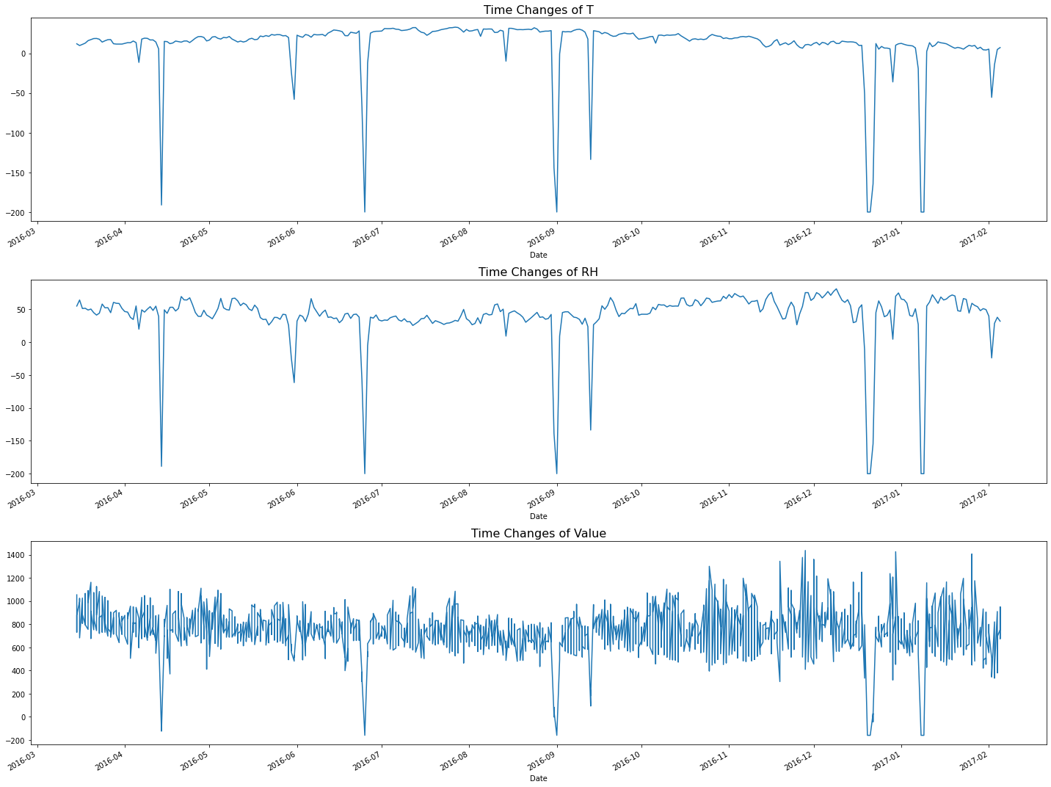
Time Series Visualisation
Summary
The Value Series looks very clustered and have many spikes which means that there is a high variance in quantity of the different gases.
There seems to have a reoccurring drop to the negative values in the series.
As it is likely unlikely for temperature and relative humidity to be in the negative value, as the lowest recorded value in the world is -89.2ºC in Antarctica at an elevation of 3420m.
Therefore, it is likely that a fault might have affected the temperature sensor and humidity sensor.
Note that because of the dips the different value would also decrease

Slide 11
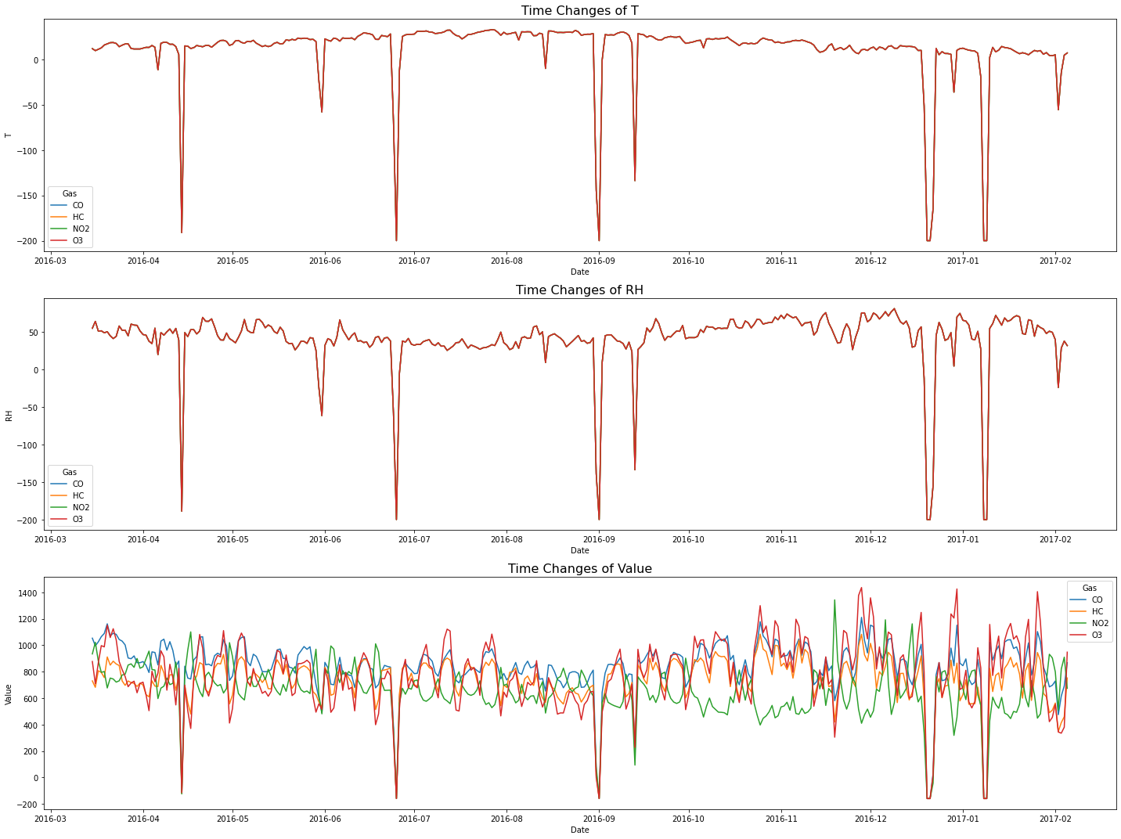
Time Series Visualisation
Summary
The data of RH and T are the same for all the different gases.
The spikes down of temperature and relative humidity is the same point where the value of the different gases down as well.

Slide 12
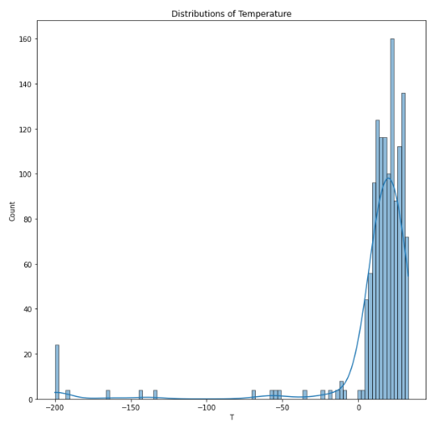
Univariate Analysis
Observations
As mentioned previously, temperature is very negatively skewed and have several points of outliers likely due to failure of sensors.

Slide 13
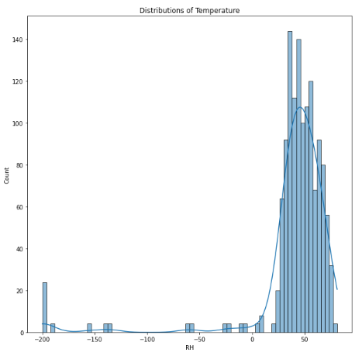
Univariate Analysis
Observations
As mentioned previously, relative humidity is very negatively skewed and have several points of outliers likely due to failure of sensors.

Slide 14
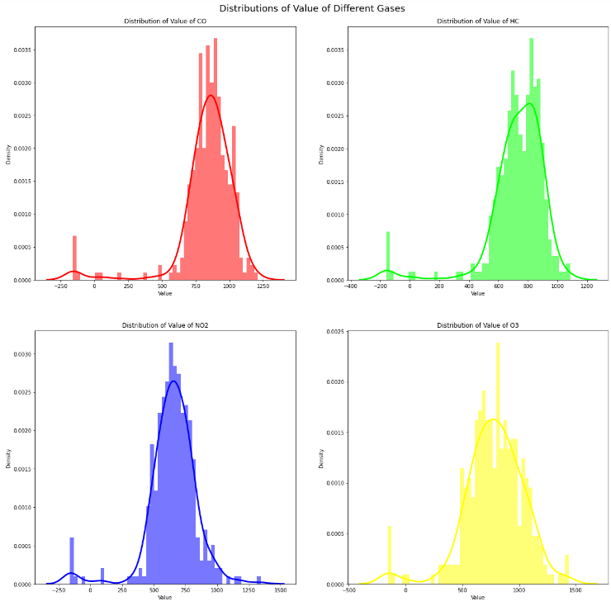
Univariate Analysis
Observations
Apart from the outliers, generally the distribution of value of the different gases is very normally distributed.

Slide 15
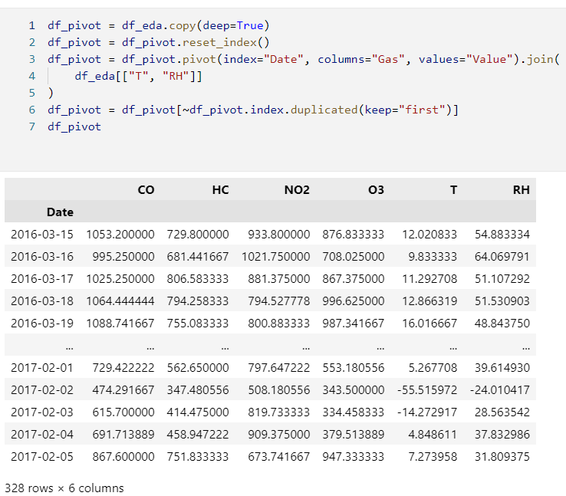
Time Series Decomposition
Before we can fix some of the outlier issue caused by the failure sensor, we will have to perform some tests to decompose the time series problem.
These tests are:
Seasonality Decomposition
Test for Causation
Test for Cointegration
Test for Stationarity
Outlier Analysis
Autocorrelation Analysis
Before we start any test, we will have to manipulate the data a bit
Observations
As mentioned previously, temperature is very negatively skewed and have several points of outliers likely due to failure of sensors.

Slide 16
Seasonal Decomposition
The seasonal decomposition is a method used in time series analysis to represent a time series as a sum (or, sometimes, a product) of three components - the linear trend, the periodic (seasonal) component, and random residuals.
In a gist, the following plots will be able to split the data into its seasonal components, trend components and remainders. And if you were to sum up the values, you will have the actual data back.
Observations
As mentioned previously, temperature is very negatively skewed and have several points of outliers likely due to failure of sensors.

Slide 17
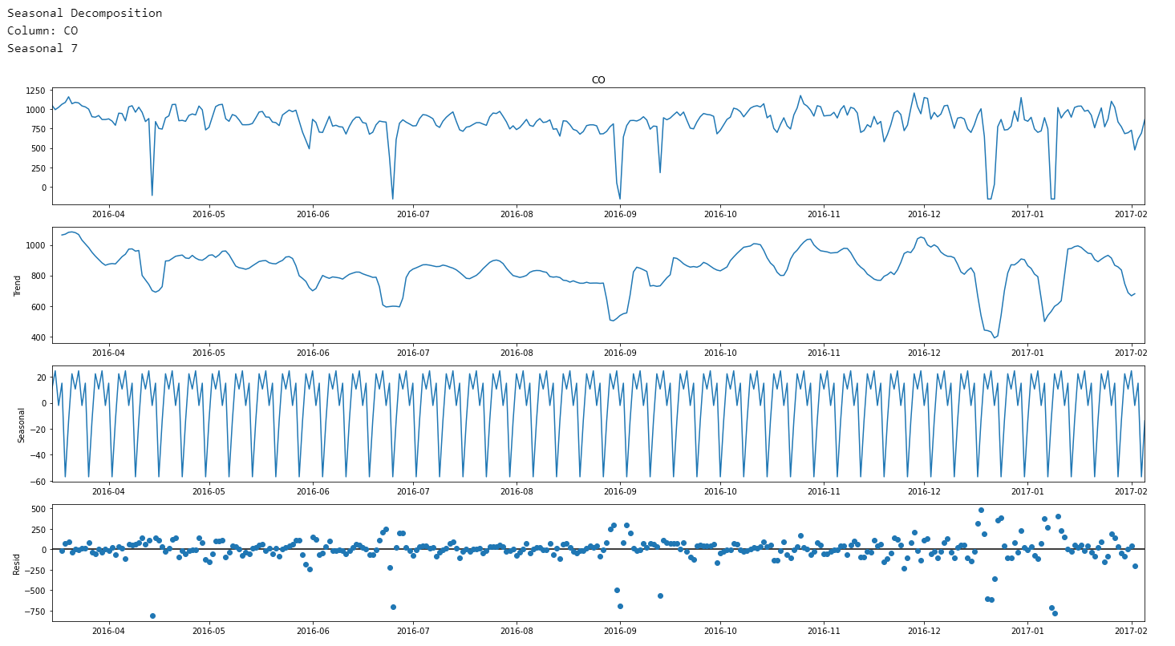
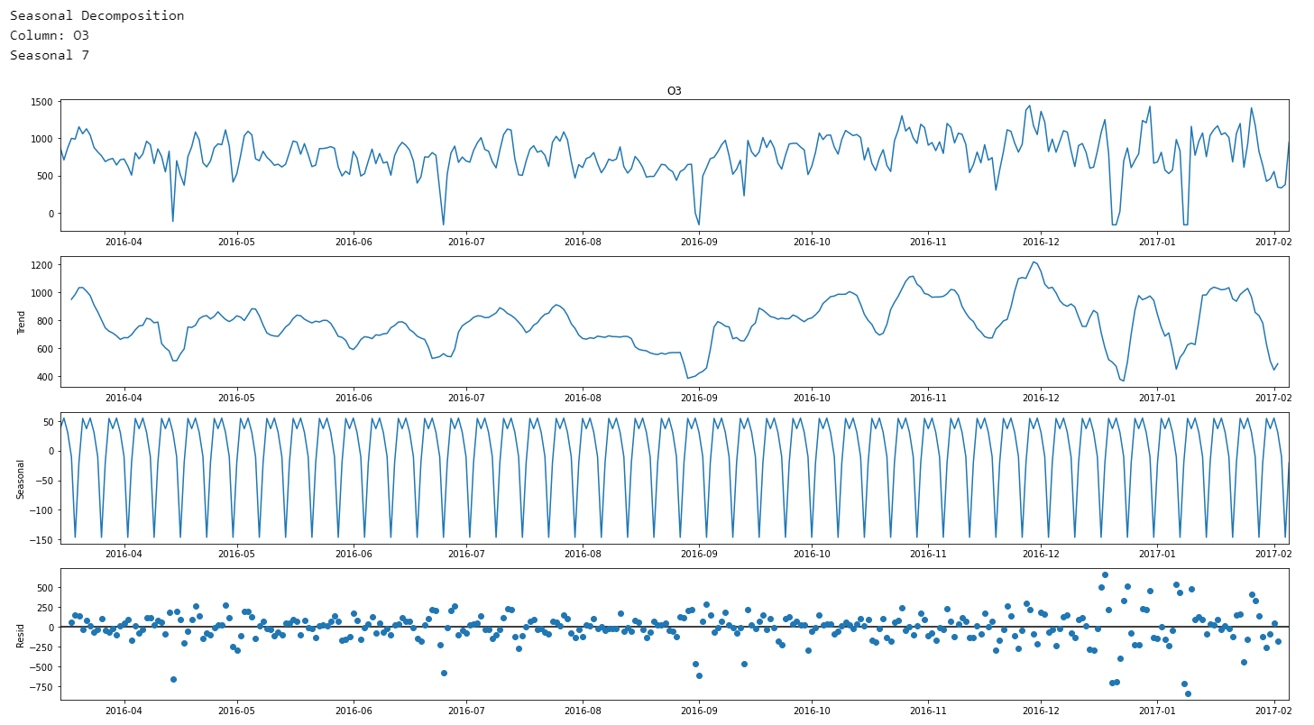
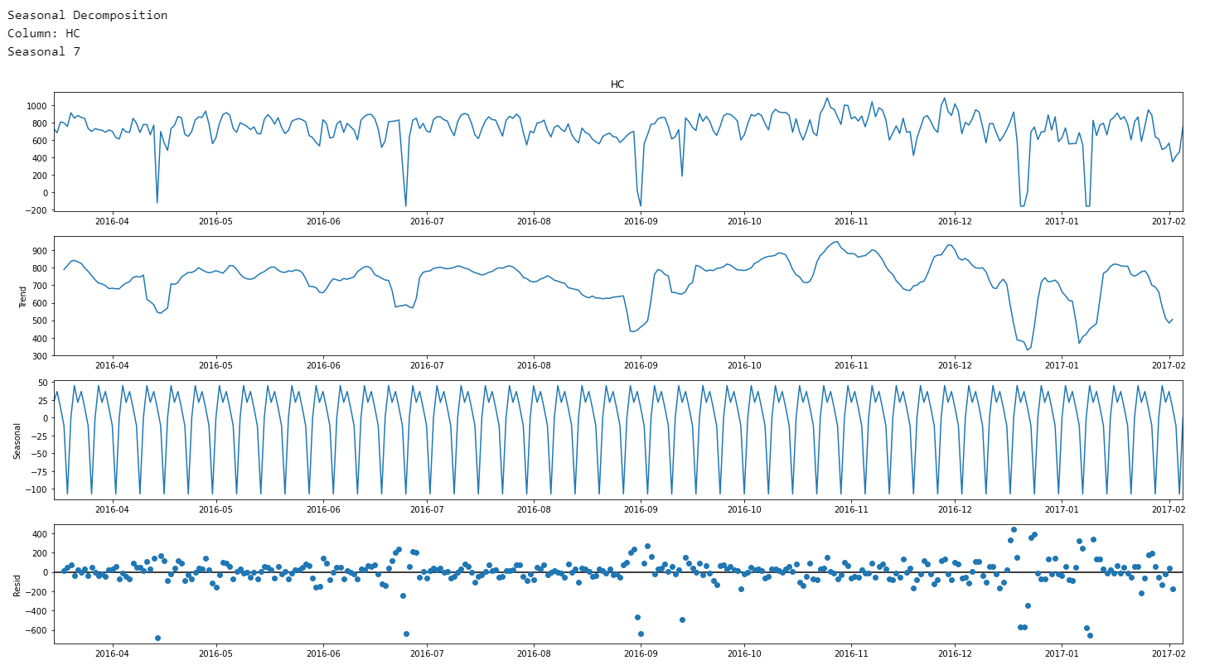
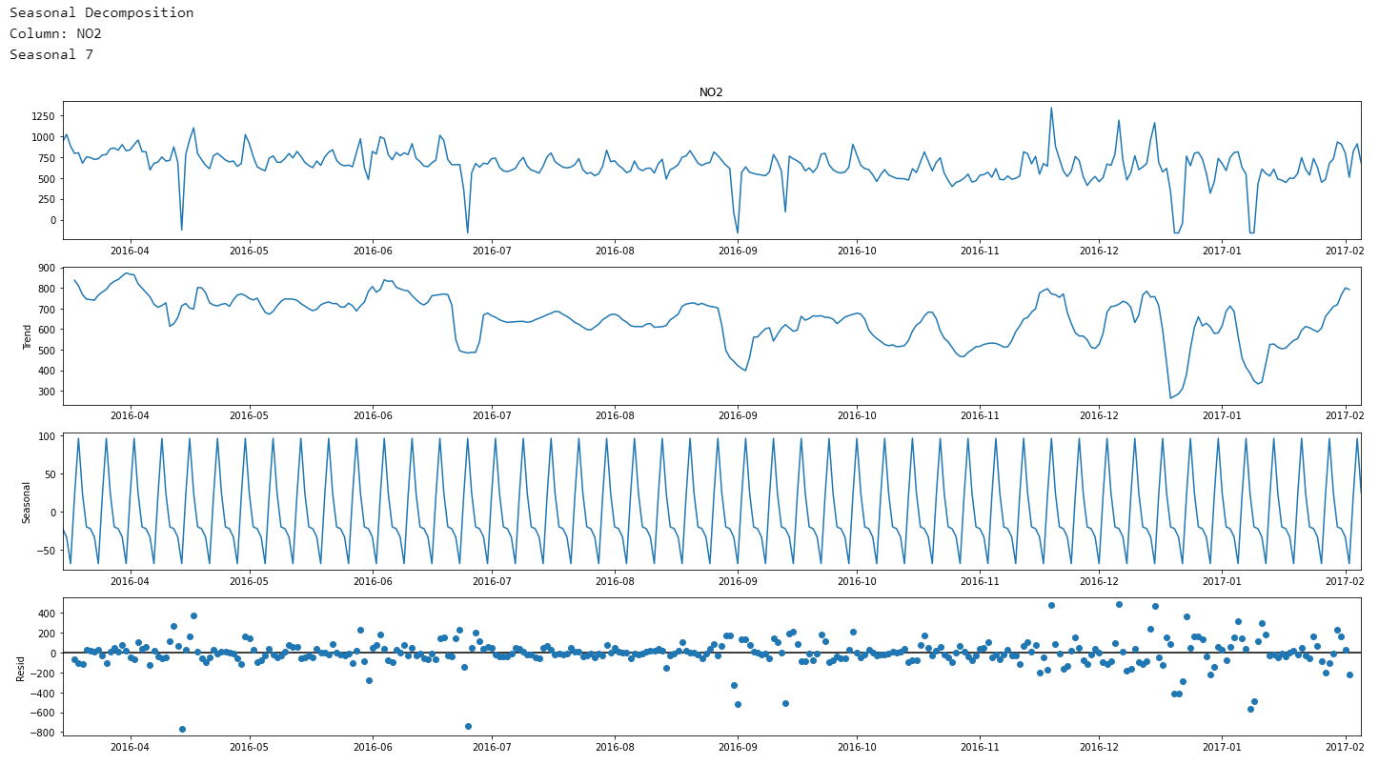

Slide 18
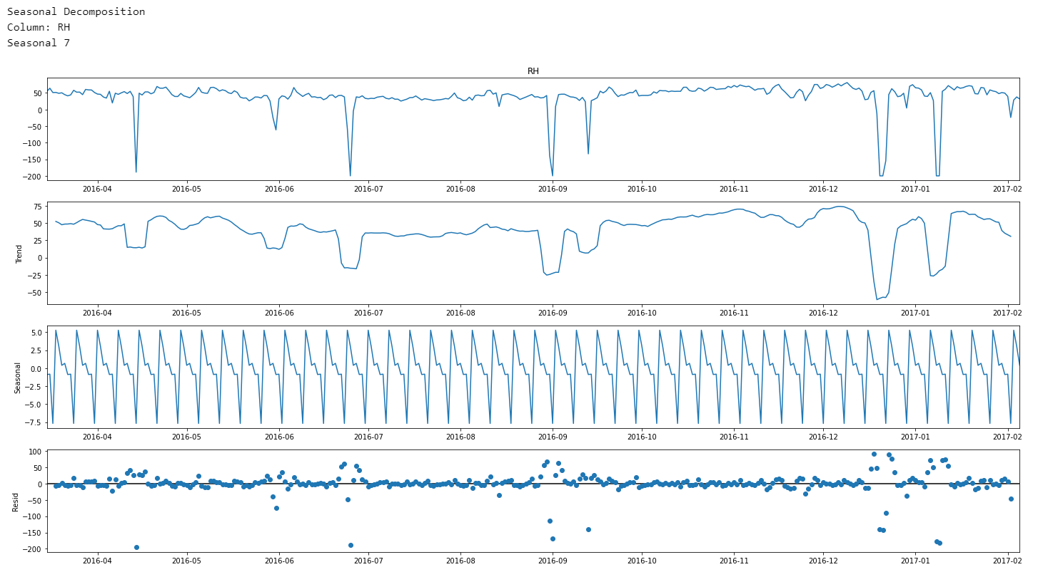
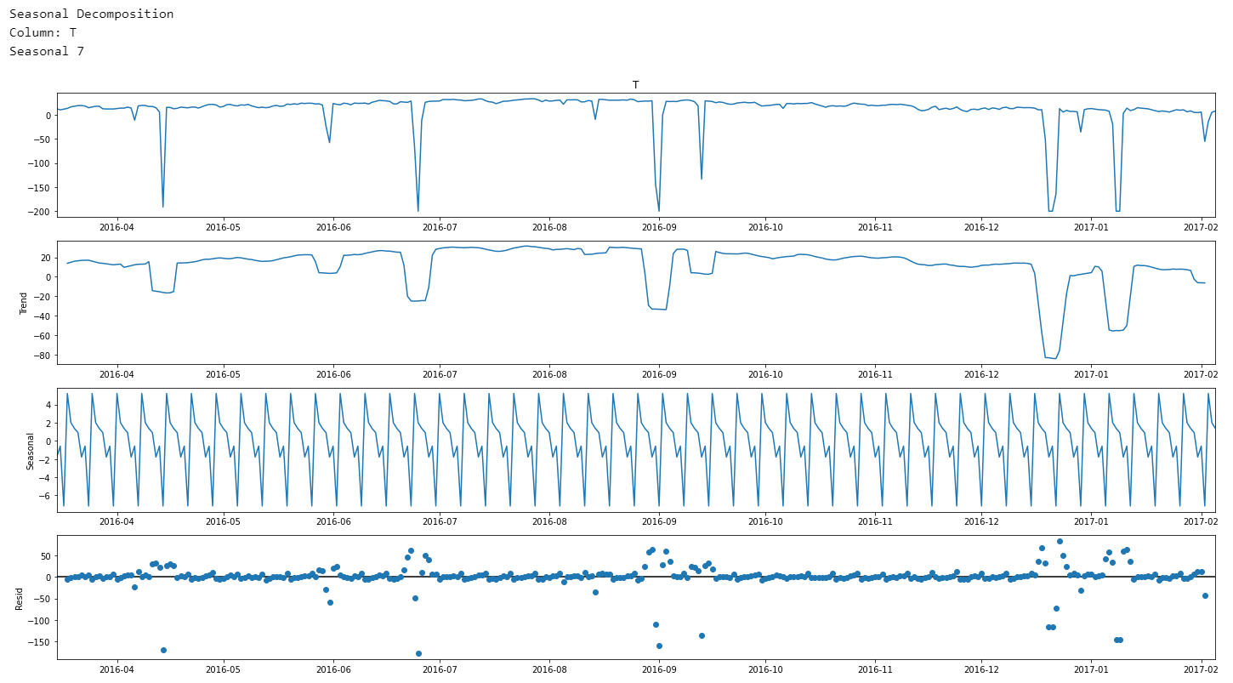
Seasonal Decomposition
There is no linear trend in the data
Seasonality is the same throughout all the variables. This repeat occurs every 5 days/steps (each tick is around 30 days as a month usually has 30 days. The repeat occurs 4 times a month which means that the repeat occurs like every 30/4 = 5 days)
The number of unique seasonal count is 7 which we will be using for the models later on
Observations
As mentioned previously, temperature is very negatively skewed and have several points of outliers likely due to failure of sensors.

Slide 19
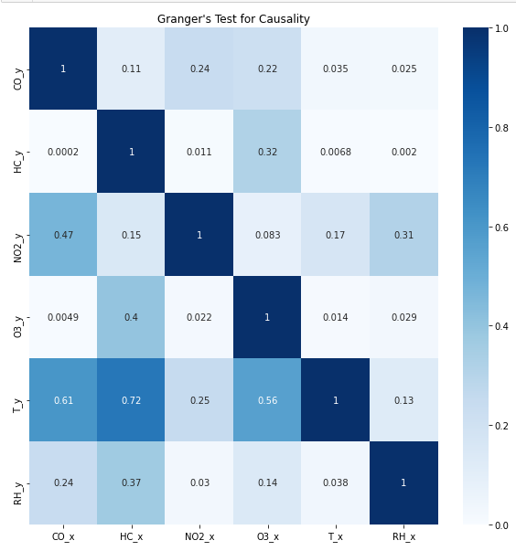
Test for Causation
We will be using the Granger causality test. It is a statistical hypothesis test for determining whether one time series is a factor and offer useful information in forecasting another time series. This will help us in concluding if a Multivariate Modelling can be used for this time series.
Granger causality test works like this.
𝐻_{o}: There is no causality between time series
𝐻₁: There is some causality between time series

Slide 20
Test for Causation
If value is less than the significant level (0.05), then we can reject the null hypothesis and conclude that the x value will granger cause y value.
Based on this, we can concluded that
Temperature granger cause CO emissions
Relative Humidity granger cause CO emissions
CO granger cause HC
NO granger cause HC
Temperature granger cause HC emissions
Relative Humidity granger cause HC emissions
O3 granger cause NO2
CO granger cause O3
NO2 granger cause O3
NO2 causes O3 depletion as NO2 + O3 -> NO3 + O2
Temperature granger cause O3 emissions
Relative Humidity granger cause O3 emissions
NO2 granger cause Relative Humidity
Temperature granger cause NO2

Slide 21
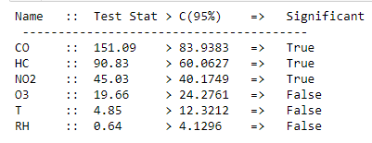
Test for Cointegration
Cointegration is a statistical method used to test the correlation between two or more non-stationary time series in the long-run or for a specified time period. The method helps in identifying long-run parameters or equilibrium for two or more sets of variables.
We will be use Johansen's cointegration test is used to established if there is a correlation between several time series in the long term, to determine if there is any significant relationship to use for Multivariate Modelling.
𝐻_{o}: There is no cointegration
𝐻₁: There is some cointegration
Observations
Ozone, Temperature and Relative Humidity does not have a significant cointegration
CO, HC and NO2 have a significant cointegration which suggest that there might be a correlation between the 3 values in the long run.

Slide 22
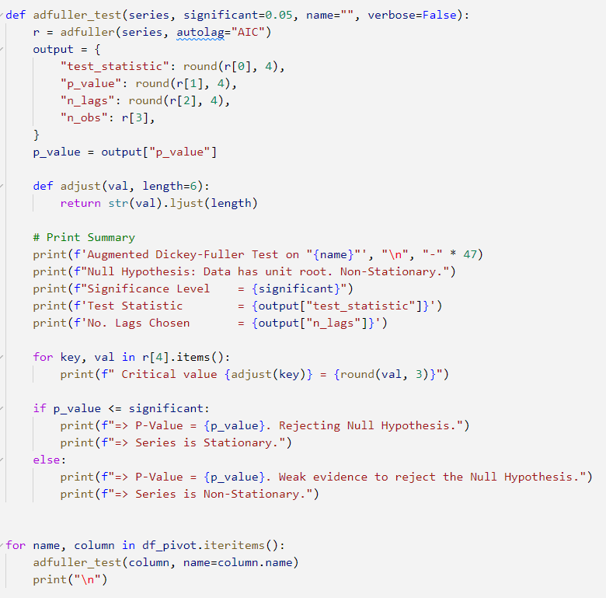
Test for Stationarity
Stationarity can be defined in precise mathematical terms, but for our purpose we mean a flat looking series, without trend, constant variance over time, a constant autocorrelation structure over time and no periodic fluctuations (seasonality).
This can be tested using the Augmented Dickey-Fuller test also known as the AD Fuller Test to test for stationarity.
𝐻_{o}: Data is not stationary
𝐻₁: Data is stationary

Slide 23
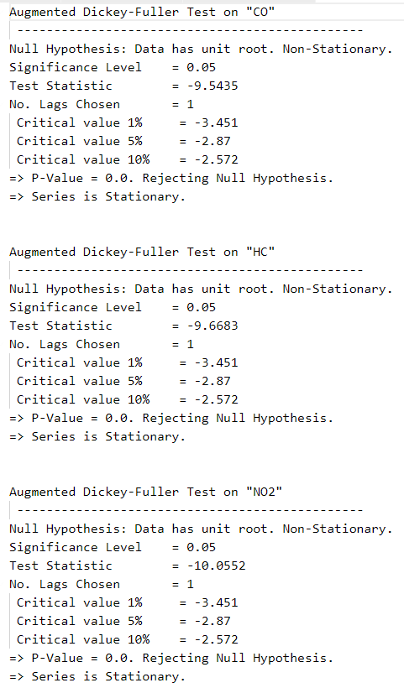
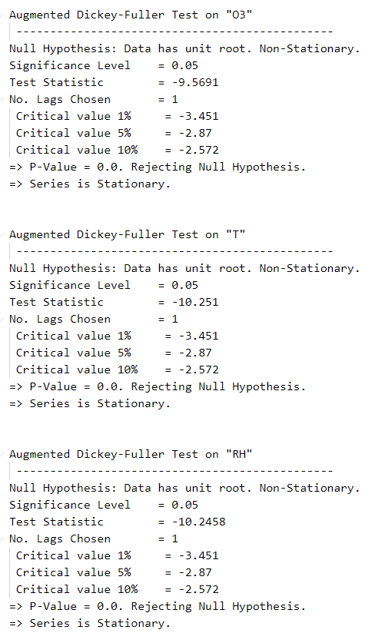
Test for Stationarity
Observations
All the time series appears to be stationary
As the P-Value of all values are 0.0, this means that which indicates very strong stationary for every variable in this time series

Slide 24
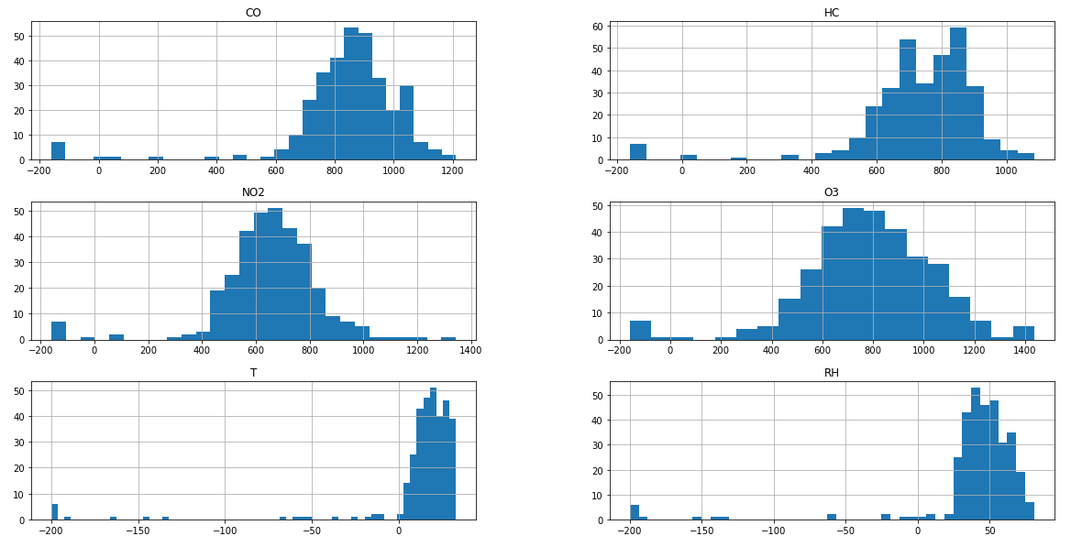
Outlier Analysis
As stated in the distribution part, the dataset has many different outliers and the data is skewed. This data should be voided, deskew or interpolated. We will analysis and see what is the suitable method and we will check if in the end is there any stationary columns.
Observations
Many values are negatively skewed which might have affected the stationarity due to the large variance between the points.
Based on the lowest temperature recorded on earth, is -89.2ºC which means the values are abnormal. To fix the temperature, we will be using the interpolation process

Slide 25
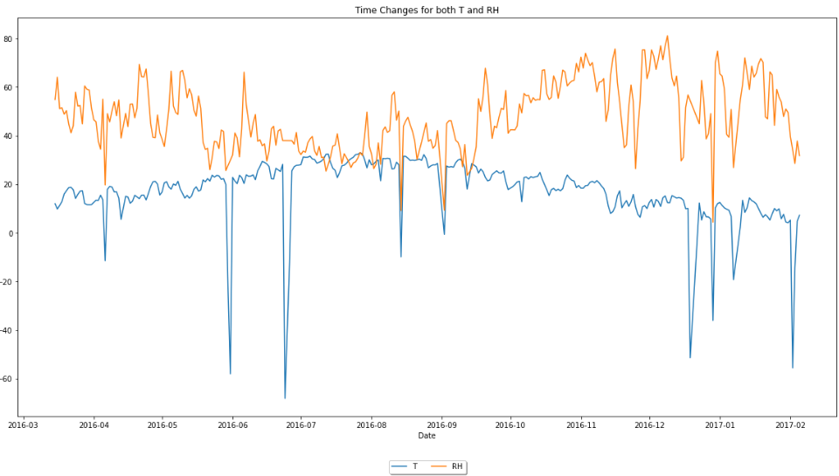
Interpolation of Data
As the lowest temperature recorded on earth is -89.2ºC, the lowest relative humidity recorded is 1 percent therefore, any values that are less than -89.2ºC and 1 percent temperature and relative humidity respectively should be interpolated.
Interpolation is the process of estimating unknown values that falls between 2 known points. We will be using the linear method to interpolate the data using the interpolation method in pandas. [Draws a straight line between the 2 points and estimate using the midway data of the 2 points]
After interpolating the data, there is a slight decrease and the dips in the data are more reasonable. However, as we have manipulated the data, the data might not be stationary any more therefore, we will have to do another AD Fuller Test

Slide 26
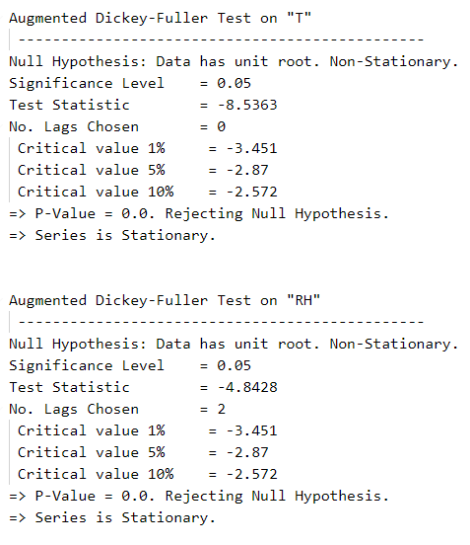
Test for Stationarity
As we only manipulated the T and RH features, we will look at the stationarity of T and RH.
We note that after interpolation, there is no change in stationarity of T and RH

Slide 27
Autocorrelation Analysis
Autocorrelation is intended to measure the relationship between a variable's present value and any past values that you may have access to. In a sense, autocorrelations can help us to see how the previous can be useful for predicting the current value of gases.
We will be using ACF and PACF to do comparison.
Autocorrelation: the degree of similarity between the time series and it's lagged version.
Partial Autocorrelation: the degree similarity between the time series and it's lagged version, without account the mutual relationship with other variables.
The plots will help us in the interpretation of the p and q values for our models below later on.
We will be also doing a comparison with the interpolated data as well as the non interpolated data

Slide 28
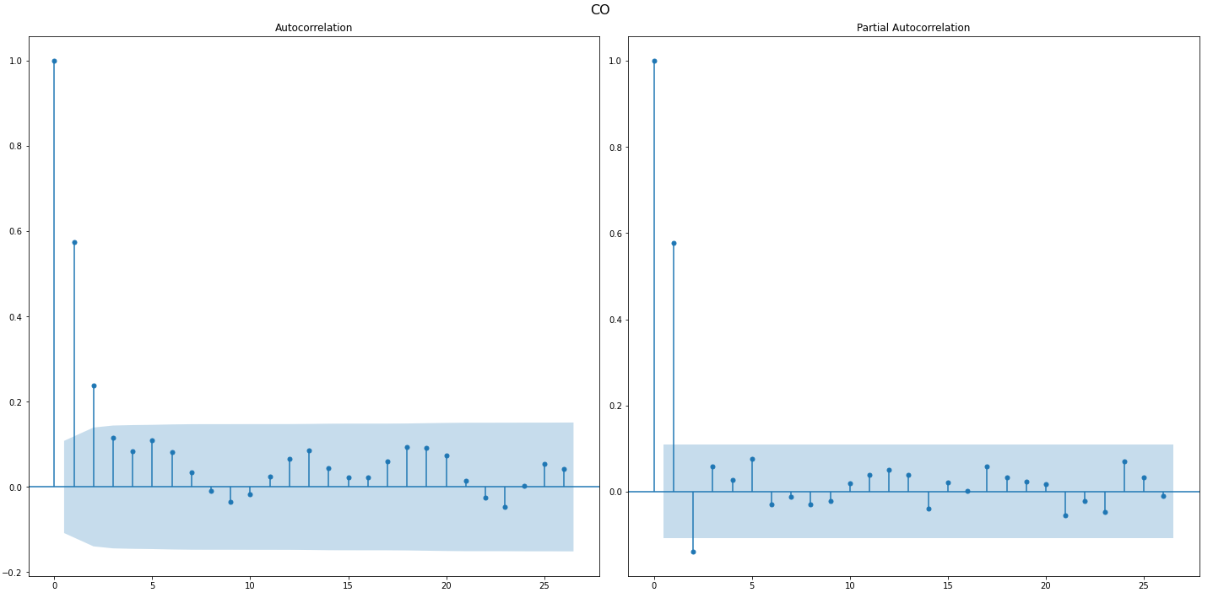
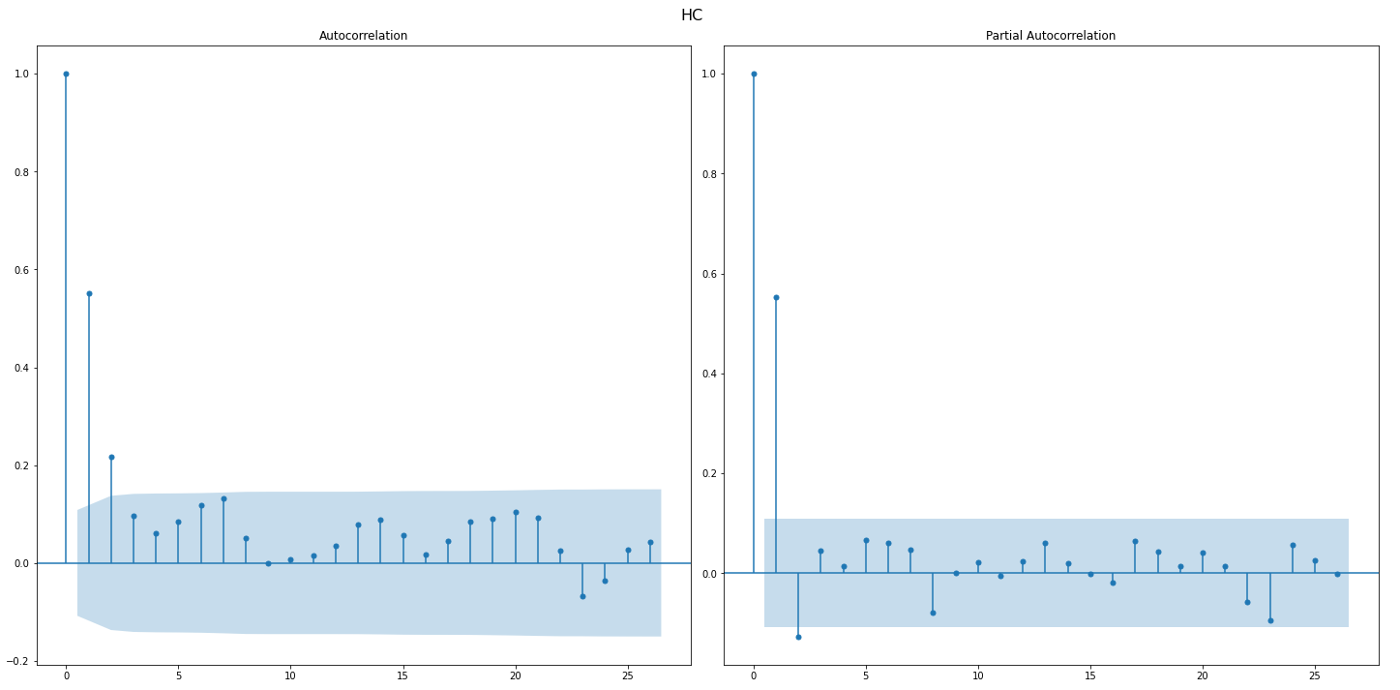
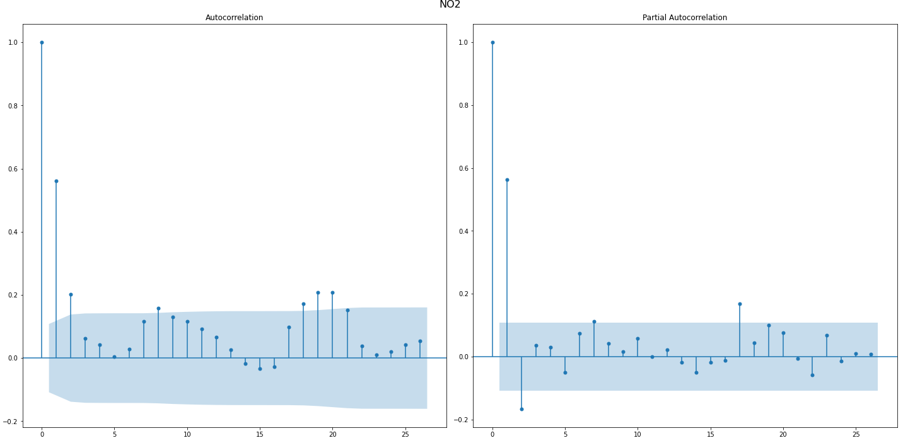
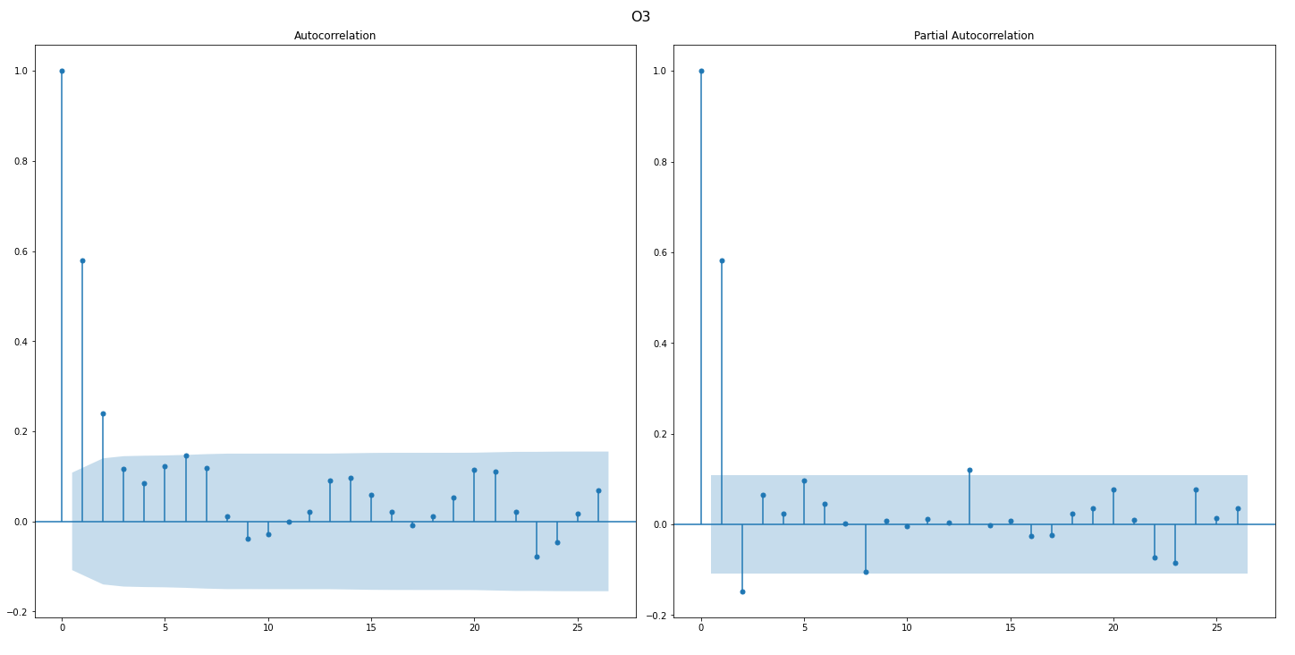
Autocorrelation of Interpolation

Slide 29
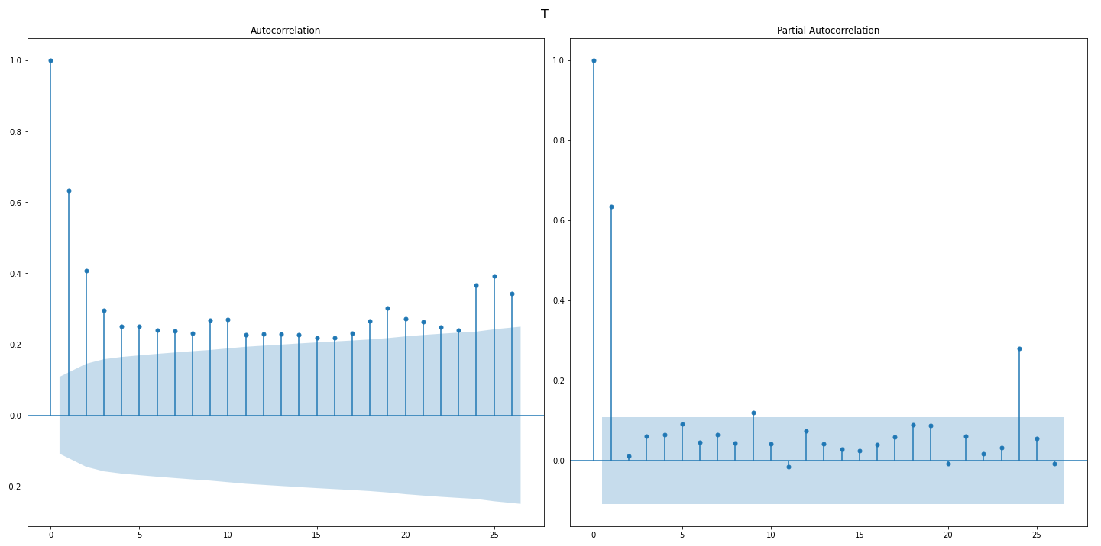
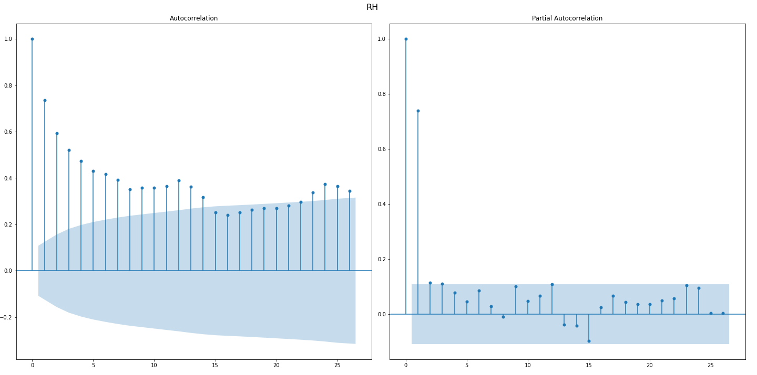
Autocorrelation of Interpolation
We notice that at zero lag, the ACF is always at zero as that variable is 100% correlated with itself. The values inside of the blue bands are statistically insignificant.
To choose the p value, we will first look at the partial autocorrelation plots. There is a significant lag spike at lag 1 for all the autocorrelation plot which makes p = 1 a prime candidate.
To choose the q value, we will look at the autocorrelation plot. Any points that are outside of the blue shaded region are potential candidates which means q = 1 - 14 is a good number. q = 1 and q = 2 are better candidates as all correlation plots have the two lags outside of the blue region.

Slide 30

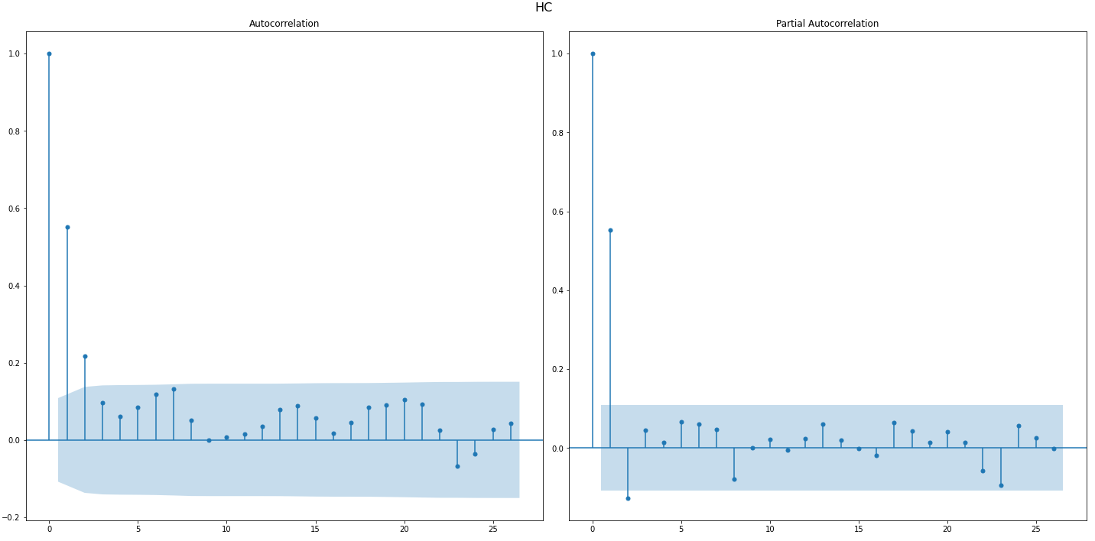
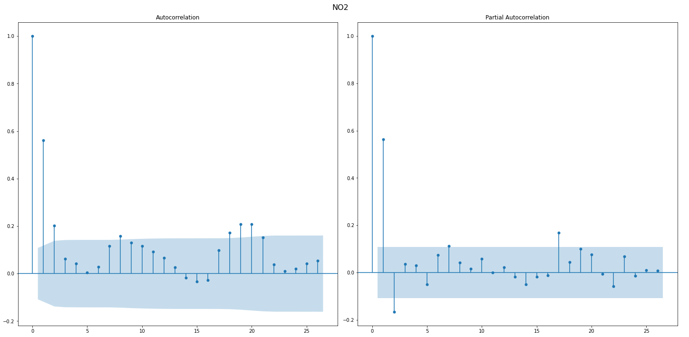
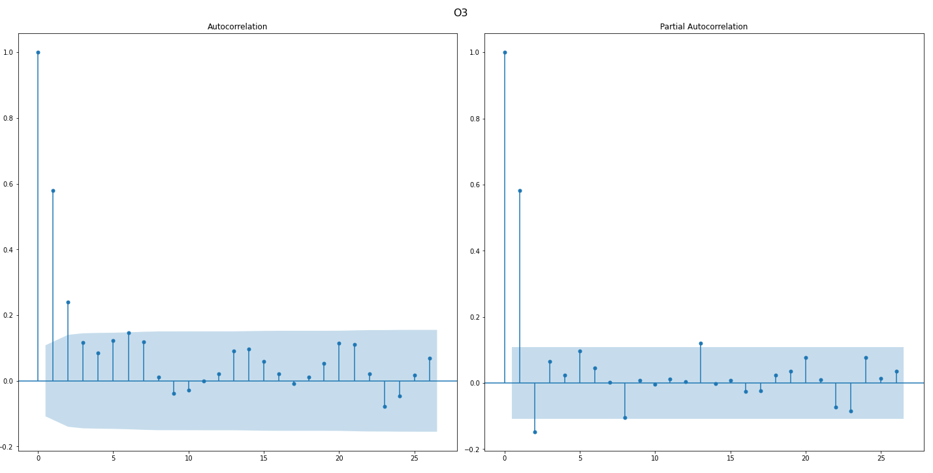
Autocorrelation of Original

Slide 31
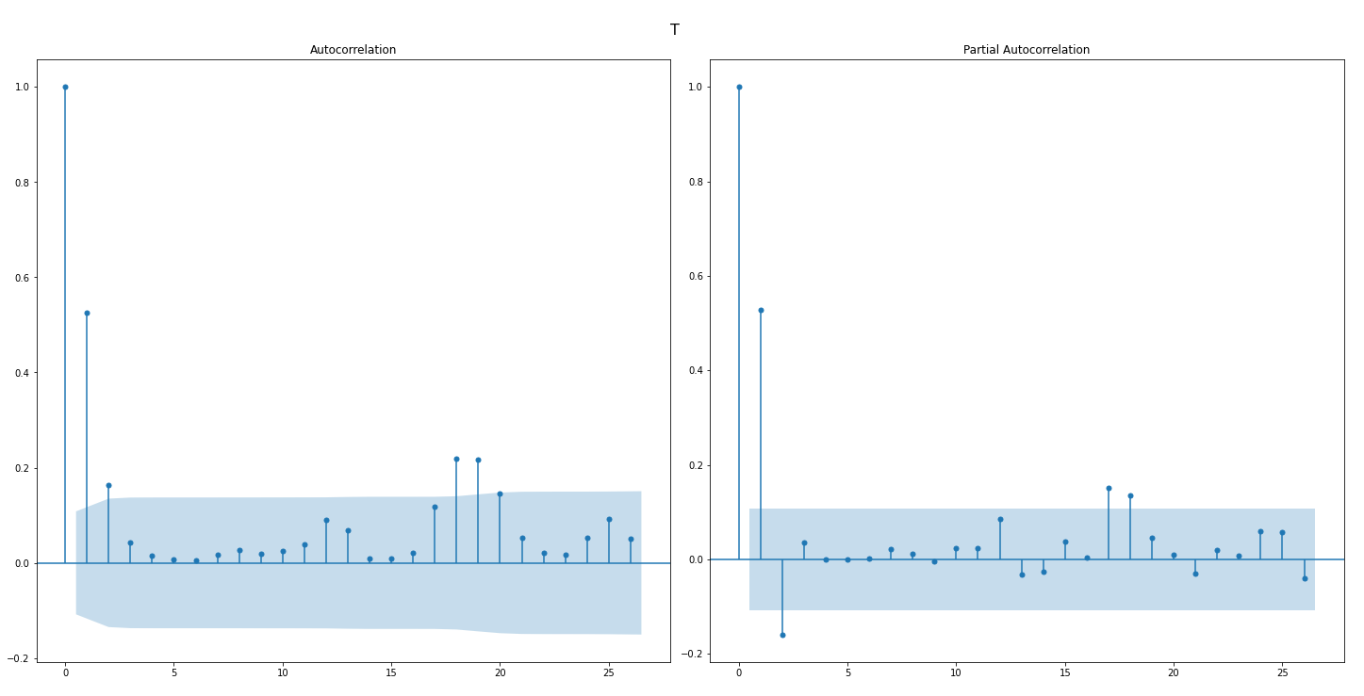
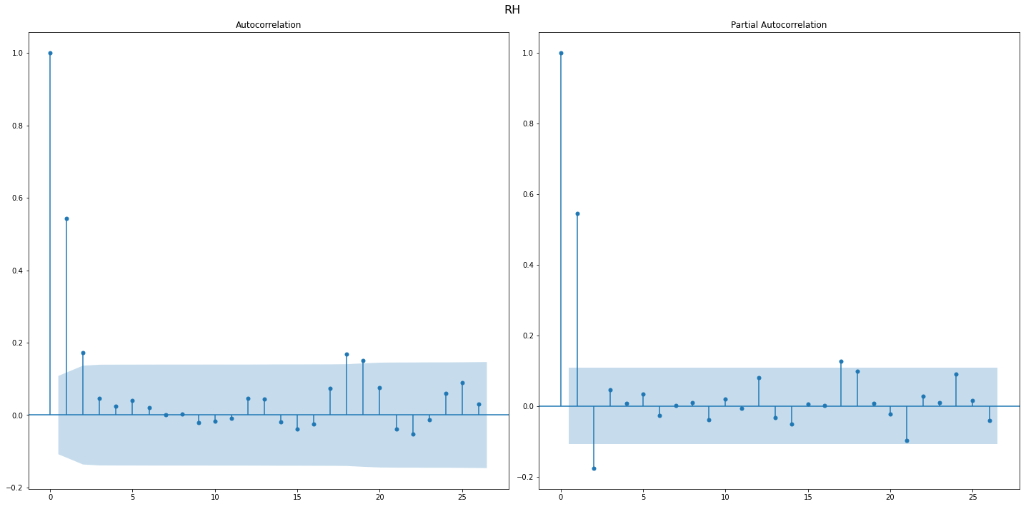
Autocorrelation of Interpolation
To choose the p value, we will first look at the partial autocorrelation plots. There is a significant lag spike at lag [0,1,2] for all the autocorrelation plot which makes p = [0,1,2] prime candidates.
To choose the q value, we will look at the autocorrelation plot. Any points that are outside of the blue shaded region are potential candidates which means q = [0,1,2] is a good number.
This values will be used to help us to get the perfect number of AR and MA to train our models
CO (p,q) = (1,2) HC (p,q) = (1,2)
NO2 (p,q) = (1,2) O3 (p,q) = (1,2)

Slide 32
Model Selection
There are many models for time series. We will be using 3 models and doing a comparison.
1. ARIMA (Baseline)
2. SARIMA
3. VARMAX
ARIMA vs SARIMA:
Autoregressive Integrated Moving Average(ARIMA) is an forecasting algorithm which takes into account the past values and predict the future value based on the autoregressive and moving average. Seasonal Autoregressive Integrated Moving Average(SARIMA) is very similar to ARIMA but SARIMA takes into account the seasonality patterns in the time series.
ARIMA & SARIMA vs VARMAX
Both ARIMA & SARIMA forecasting for a stationary time series is nothing but a linear (like a linear regression) equation. While the VARMAX procedure enables you to model the dynamic relationship both between the dependent variables and also between the dependent and independent variables. VARMAX models are defined in terms of the orders of the autoregressive or moving-average process (or both).
The gist is that ARIMA & SARIMA is used for univariate data while VARMAX is used for multivariate data. SARIMA takes into account seasonality and ARIMA does not.

Slide 33
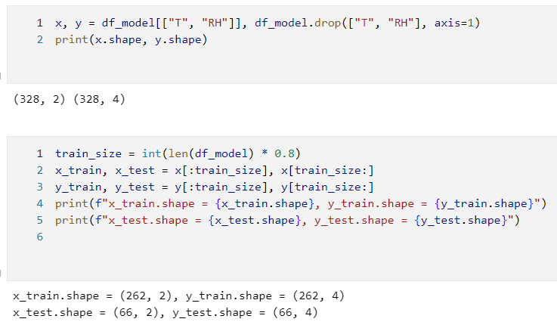
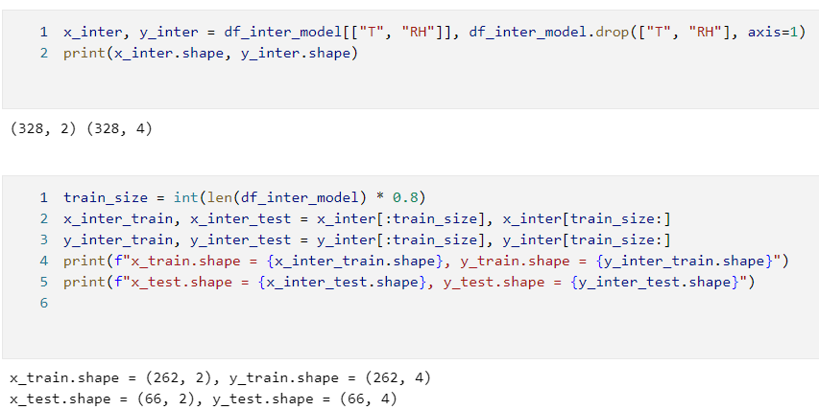
Splitting Data
We will be splitting the data into 2 dataframe, a train data and a validation data.
We will be doing it for both interpolated and original data.
We will be splitting the data into a 80:20 ratio.

Slide 34
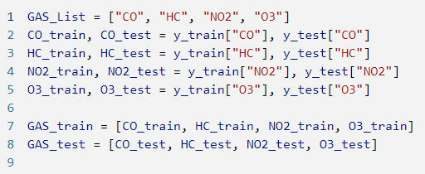
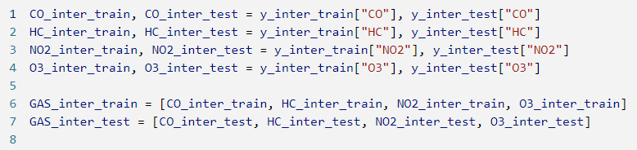
ARIMA & SARIMA
As mentioned, ARIMA & SARIMA are univariate models. We will have to split the gases into 4 different parts

Slide 35
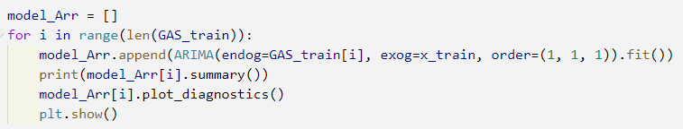
ARIMA (Baseline)
We will be using the order (1,1,1) to fit the model for all 4 gases. We will be printing the model summary and plotting a diagnostics plot to see the model’s performance

Slide 36
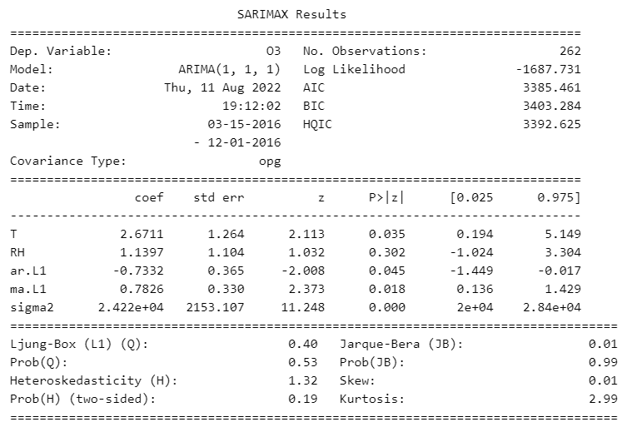
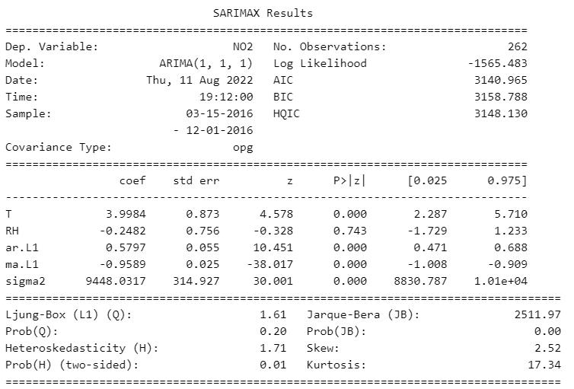
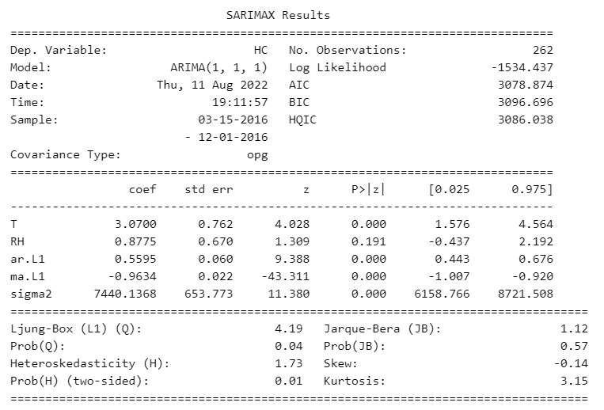
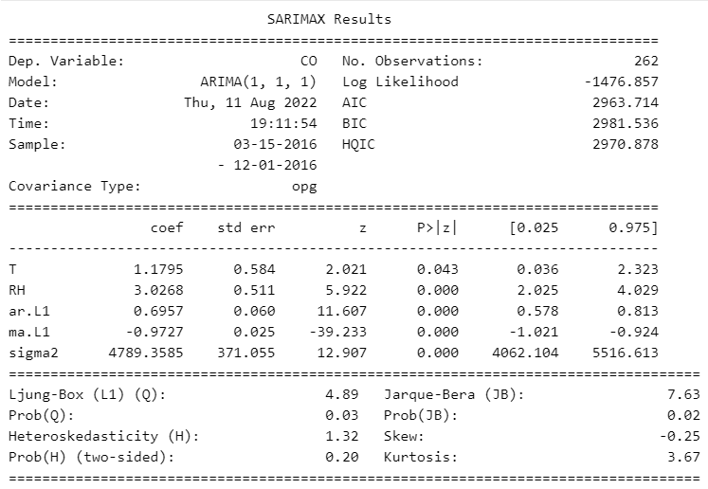
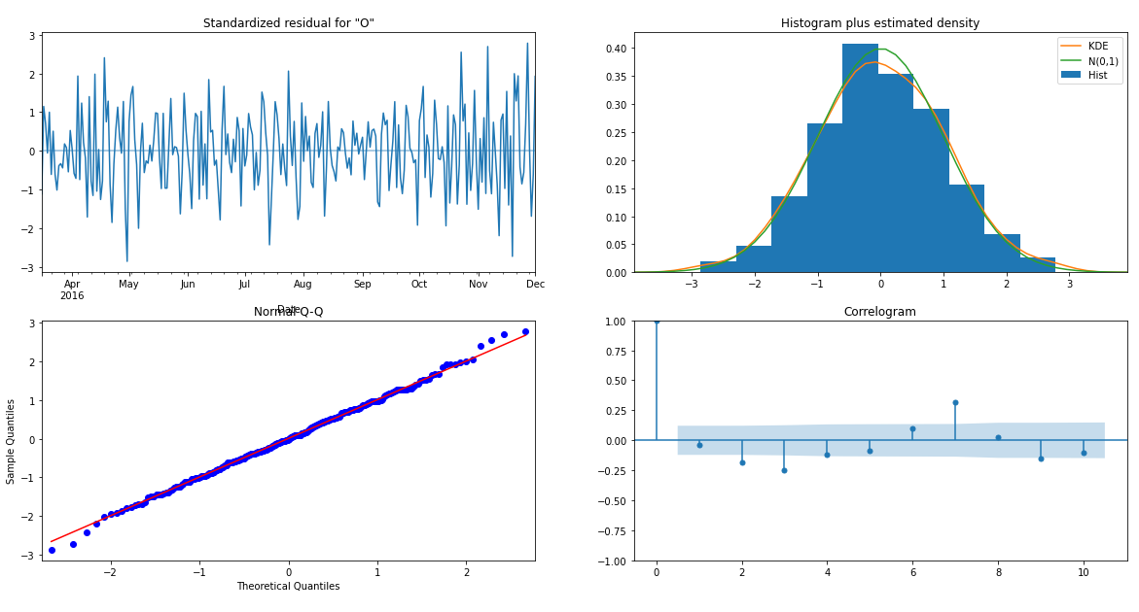
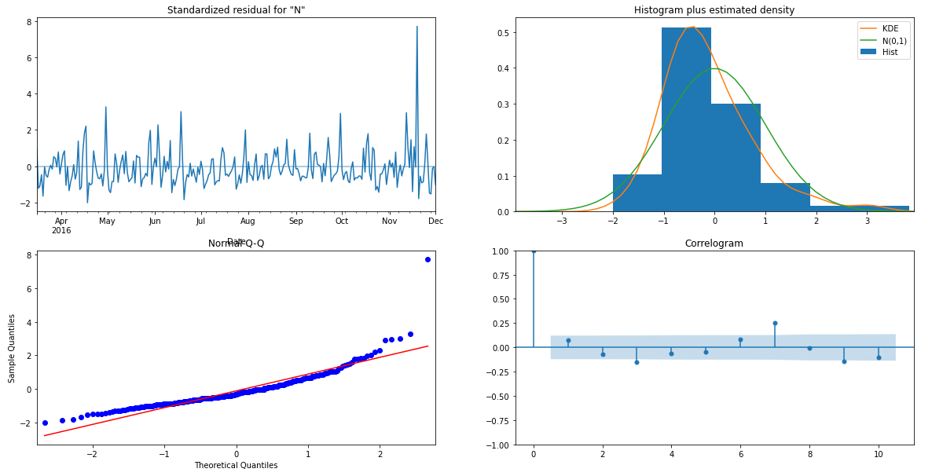
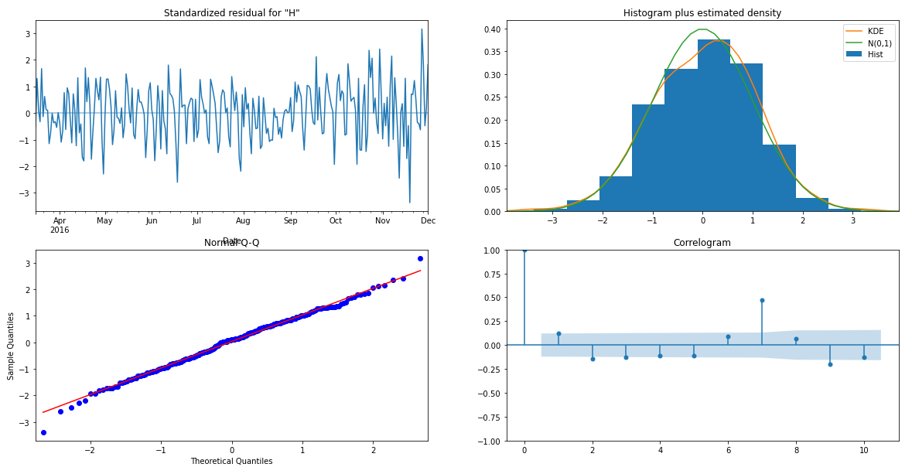
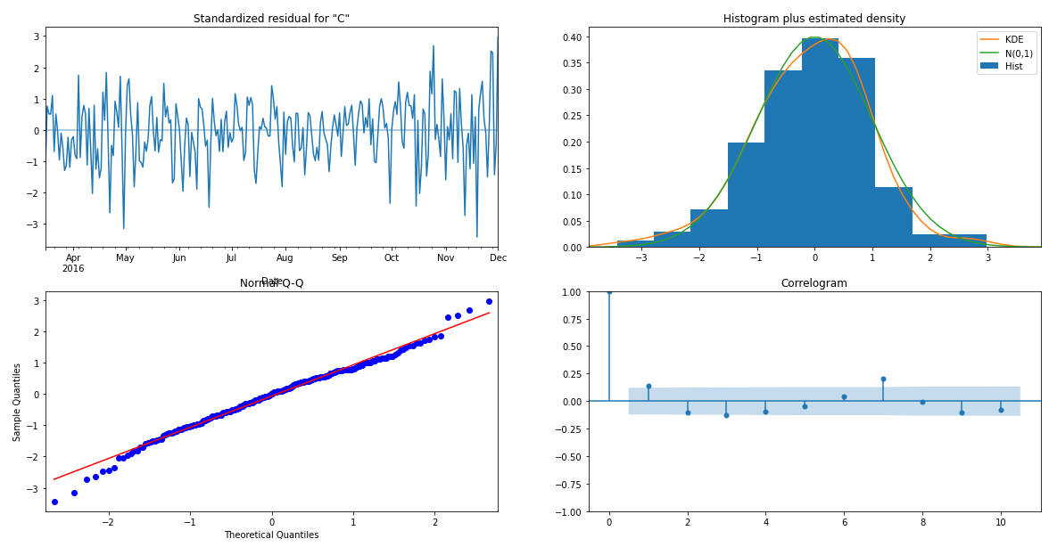
ARIMA (Baseline)

Slide 37
Interpreting Summary Notes
In the P>|z| column, it represents the term significance using a hypothesis testing with the following hypothesis
𝐻_{o}: Each coefficient is NOT statistically significant
𝐻₁: Each coefficient is statistically significant
The Ljung-Box (L1) (Q) is the LBQ test statistic at lag 1. It is used as a hypothesis testing for the following hypothesis
𝐻_{o}: The errors are white noise
𝐻₁: The errors are not white noise
Heteroskedasticity (H) tests that the error residuals are homoscedastic
or have the same variance.
𝐻_{o}: The residuals show variances
𝐻₁: The residuals show no variances
Jarque-Bera tests for the normality of errors.
𝐻_{o}: Data is normally distributed against an alternative of another distribution
𝐻₁: Data is not normally distributed against an alternative of another distribution

Slide 38
Interpreting Summary Notes
The log-likelihood function identifies a distribution that fits best with the sampled data.
Akaike’s Information Criterion (AIC) helps determine the strength of the linear regression model. The AIC penalizes a model for adding parameters since adding more parameters will always increase the maximum likelihood value.
Bayesian Information Criterion (BIC), like the AIC, also punishes a model for complexity, but it also incorporates the number of rows in the data.
Hannan-Quinn Information Criterion (HQIC), like AIC and BIC, is another criterion for model selection; however, it’s not used as often in practice.

Slide 39
Interpreting Plot Diagnostics
Residuals
The difference between the observations and the corresponding fitted values.
A good forecast will yield the following:
1. The residuals are uncorrelated. If there are correlations between residuals, then there is information left in the residuals which should be used in computing forecasts.
2. The residuals have zero mean. If the residuals have a mean other than zero, then the forecasts are biased.

Slide 40
Summary of ARIMA Models
CO
All coefficients are statistically significant
The errors caused are white noise
The residuals show no variances
Data is normally distributed against an alternative of another distribution
HC
All coefficients are statistically significant
The errors caused are white noise
The residuals show variances
Data is not normally distributed against an alternative of another distribution
NO2
RH is not statistically significant as its p-value is 0.302 which is > 0.05
The errors caused are not white noise
The residuals show variances
Data is normally distributed against an alternative of another distribution
O3
RH is not statistically significant as its p-value is 0.743 which is > 0.05
The errors caused are not white noise
The residuals show no variances
Data is not normally distributed against an alternative of another distribution

Slide 41
Summary of ARIMA Models
In conclusion, each model will need to be tuned further using their respective orders collected through the autocorrelation and partial autocorrelation plots. Based on the residuals from all the models, it is generally centered to 0 which means it is generally correct however there are a lot of spikes which means the residuals are very staggered. The histogram suggest that the residual may not be normal as they are left skewed, left skewed, right skewed and right skewed respectively for CO,HC,NO2,O3. There is also a spike in correlogram value of 7. This is likely due to the fact that there is a seasonality of 7 in this Time Series which makes lag 7 an important values. This will be remedied using SARIMA as it takes into account for seasonality.

Slide 42
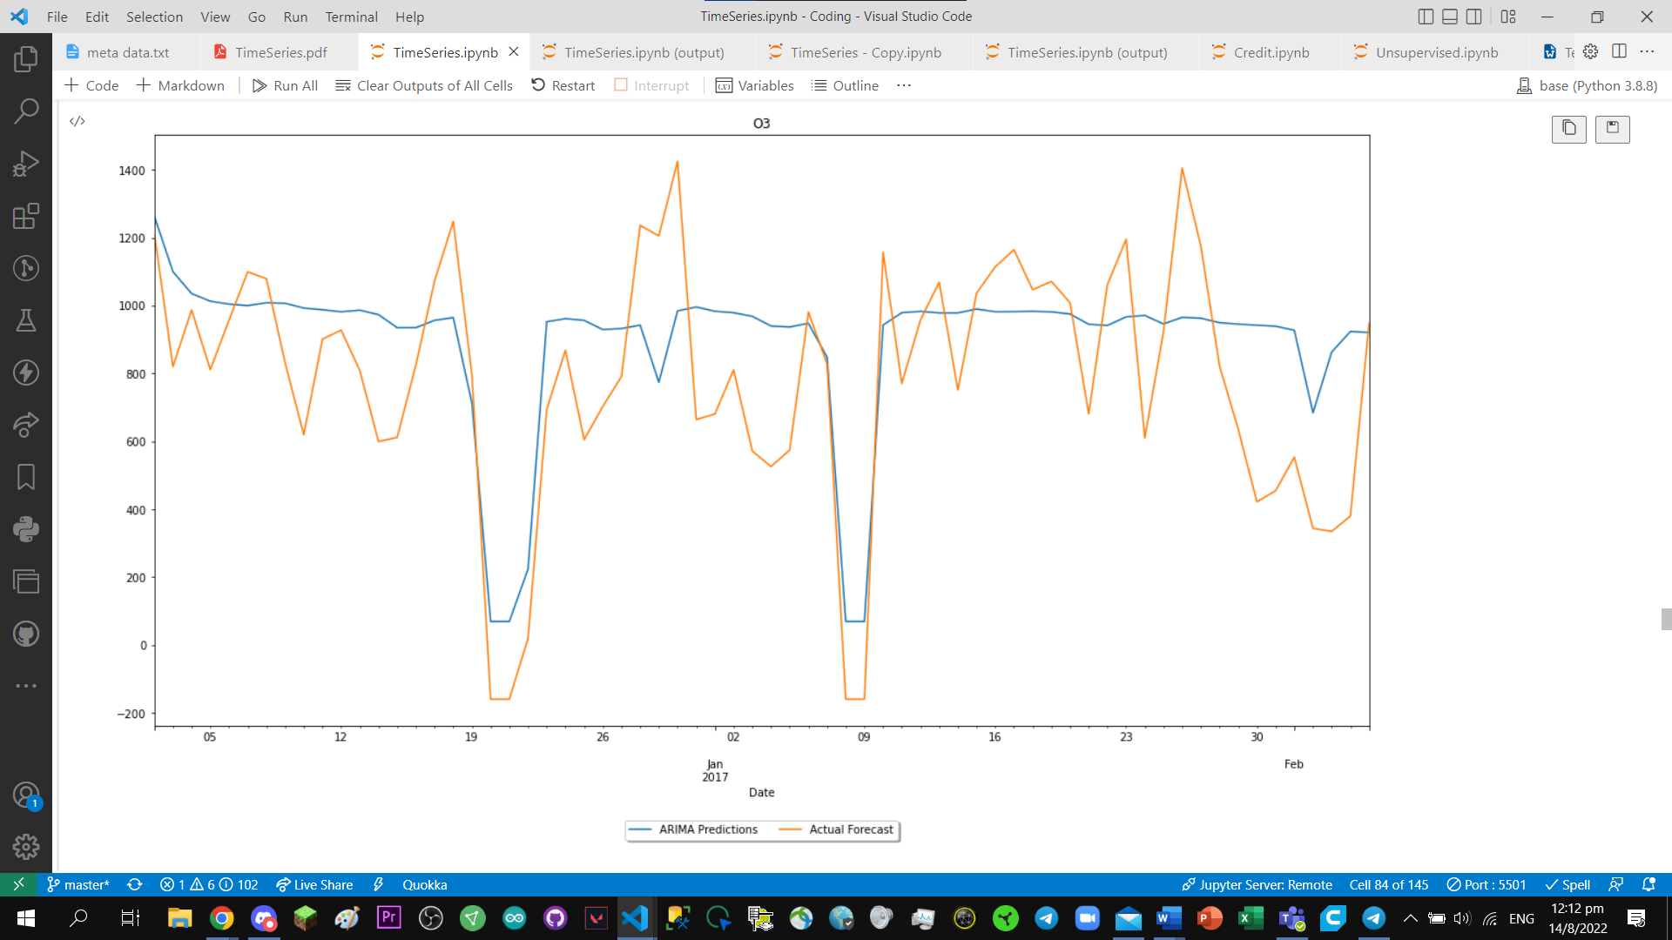
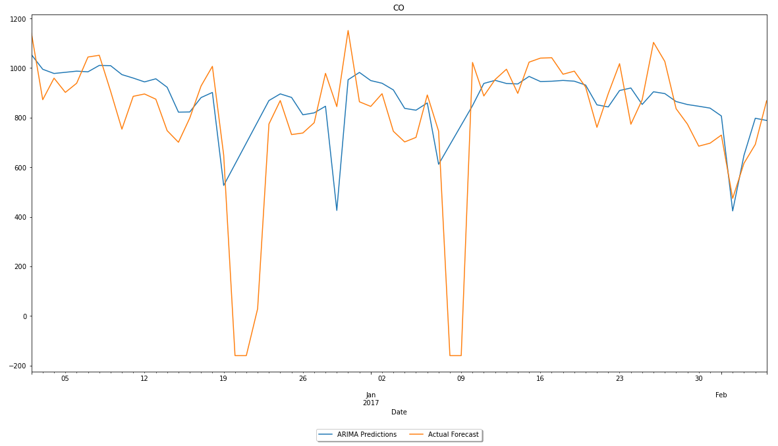






ARIMA predicts Interpolated

Slide 43
ARIMA predicts Original

Slide 44
Interpolated vs Original
As we can see from the predicted values and graphs, the interpolated dataset did not perform as well as the original dataset, this is because we have proven in our causation test that the variables are related through granger causation and since we edited the variables, the prediction will be off. Furthermore, future readings may also fail which we might also need to predict so that we know when the sensors could potentially fail at and fix it in case of emergencies. Because of this, we will be using the no interpolated data(original data) for the rest of the time series predictions.
Example of CO: Interpolated VS Original

Slide 45








SARIMA
SARIMA will be used to compare with the baseline ARIMA in terms of performance. It should perform better due to SARIMA using more computation power to predict inclusive with seasons. Based on seasonality decomposition, we know that all variables have a seasonality of 7.

Slide 46
Summary of SARIMA
CO
All coefficients are statistically significant
The errors caused are not white noise
The residuals show no variances
Data is not normally distributed against an alternative of another distribution
HC
RH is not statistically significant as its p-value is 0.389 which is > 0.05
The errors caused are not white noise
The residuals show variances
Data is not normally distributed against an alternative of another distribution
NO2
RH is not statistically significant as its p-value is 0.845 which is > 0.05
The errors caused are not white noise
The residuals show variances
Data is normally distributed against an alternative of another distribution
O3
RH is not statistically significant as its p-value is 0.155 which is > 0.05
The errors caused are not white noise
The residuals show no variances
Data is not normally distributed against an alternative of another distribution
Conclusion
In conclusion, each model will need to be tuned further using their respective orders collected through the autocorrelation and partial autocorrelation plots. Compared to the ARIMA model, SARIMA performed better than it as the residual plot is more close to 0 with slightly less variation. In the correlogram plot, there is no lag that is outside of the 5% range which is good.

Slide 47




SARIMA predicts Original

Slide 48
Comparing SARIMA with ARIMA
When comparing Time Series models, we look at the AIC and BIC. The lower the AIC and BIC, the better the models performance. AIC as mentioned helps determine the strength of the linear regression model and would emphasis more on model performance (select more complex models) and BIC as mentioned helps to select the true model of the dataset which follows more strictly to the original training dataset this causes the it to select a more simple model which focuses more on getting the data to work. This means AIC and BIC needs to be balanced.
Based on the SARIMA and ARIMA summary, the SARIMA models have a decrease in AIC and BIC score by around 50 - 300 points. This means that with the inclusion of the seasonality, the model performs better.
Furthermore, based on the side by side comparison of the model prediction on the validation set it seems SARIMA follows the trend of the actual forecast more closely compared to ARIMA.

Slide 49

Diagnosing Baseline SARIMA Model
As Time Series is similar to a regression problem, we will be using the following scoring metrics to help us in the time series
Mean Absolute Percentage Error
A measure of prediction accuracy of a forecasting method in statistics
Root Mean Squared Error
RMSE is the square root of the mean of the square of all of the error. We use RMSE more often as MSE values can be too big to compare easily. MSE shows how close the data points are closely fitted to a line.
Summary
CO has the lowest difference and the forecasting ability is quite good as the RMSE of the validation
and RMSE of the training set is relatively close.
HC has a good training forecast but once it has reached the validation set, it did not perform as
well as intended. Parameters can be adjusted and orders can be used to improve on the models performance.
NO2 has a good training and validation RMSE and is relatively close which means that the order is
quite good for prediction of NO2 gas. Graphically, the data points do not spike up when need.
O3 has a good training forecast but not a strong validation forecast. The dips and spikes are not
very clear which needs to be adjusted.

Slide 50

Cross Validation - Expanding Window
To validate and make sure the model is evaluated general potential. One way to achieve this is to train the data using the passage of time in different windows.

Slide 51

SARIMA Cross Validation
A general observations is that as time/window is expanded, the RMSE score fluctuate. AIC and BIC seems to increase as time increases this is likely due to the fact that more data and time is given to the model and more process is needed to be computed which increase the computational complexity.

Slide 52

SARIMA Hyperparameter Tuning
To enhance the model, we will need to find the best order. Although we can find the value of p and q using the autocorrelation and partial autocorrelation plots. We can use loops to look through the best values. We are making us of a function that works quite similar to the GridSearchCV from sklearn.

Slide 53


SARIMA CO Results
Seasonal Order: (3, 1, 3, 7)
It has the lowest MPE and the valid RMSE is close to the lowest valid RMSE

Slide 54


SARIMA HC Results
Seasonal Order: (0, 1, 1, 7)
The model has the best AIC and BIC which means the models is not complex but performs well
The valid RMSE is also very close to the lowest valid RMSE

Slide 55


SARIMA NO2 Results
Seasonal Order: (3, 1, 0, 7)
The model has the lowest valid MAPE and the valid RMSE is close to the lowest valid RMSE

Slide 56


SARIMA O3 Results
Seasonal Order: (4, 1, 1, 7)
The model has the lowest valid RMSE and the AIC and BIC is close to the lowest AIC and BIC

Slide 57
VARMAX
As mentioned previously, VARMAX is able to handle multiple data and time series together. Furthermore, we have shown in the Causality and Cointegration Test at least 2 time series influence each other. Therefore we will use a multivariate regressor like VARMAX.

Slide 58




VARMAX Summary

Slide 59


VARMAX Plot Diagnostics
Residual plot is not very varied, the Histogram of residual states that the residuals are quite normally distributed. In the correlogram plot, Lag 1 and 2 appears to be outside the range of 5% which means that the model might require some tuning
Observations
The model performed very well at the training data and might have a bit of a hiccup in the validation data due to MAPE being more than 100%
Both RMSE are relatively close to 0 which means VARMAX model is strong

Slide 60

VARMAX predicts Original
The predict values do not have the splits and dips that the time series have which can means that the order selected was not the best. More needs to be done to make the model better

Slide 61

VARMAX Cross Validation
The order (1,1) has a good valid rmse and train rmse as it is close to 0. We note that VARMAX models take a lot of penalties for AIC and BIC due to it being a more complex model and takes more computational power compared to SARIMA and ARIMA.

Slide 62

VARMAX Hyperparameter Tuning
The order (0,7) performed the best as it has the lowest valid rmse. We also note that by increasing the p value (Auto Regressive) makes the score worst as the valid rmse increase drastically when it is added.
Order (0,8) is also relatively good as it has the lowest train rmse and train_mape.

Slide 63
Model Selection
Based on the valid rmse, generally VARMAX performs more effectively compared to SARIMA. This is likely due to the correlation between the different variables that VARMAX is able to use in assistance to the model which means that we will be using VARMAX as the main model.

Slide 64

Kaggle Test Set Predictions
After we are satisfied with the model performance on the train and validation set, it is about time for us to generate the final prediction for the test set and submit it on the Kaggle competition page.
We will be using the test set to prepare the exogenous set for testing

Slide 65

VARMAX predicts Test
We will be using (0,7) as our order as shown in the cross validation that it performed the best.
We will store the values inside a csv for submission.
Kaggle Scores:
RMSE: 152.09558

Slide 66

VARMAX predicts Test
We will be using (0,8) as our order as shown in the cross validation it has the 2nd best parameters
We will store the values inside a csv for submission.
Kaggle Scores:
RMSE: 151.68211

Slide 67
Summary
We are able to create an forecasting model to predict air pollution in the air. With climate change being a constant threat to mankind's survival, we should start keeping the environment clean. However, the model still faces some limitations. It has only been trained and tested on an older set of data point from 2016 - 2018. As technology advances and human life advances, more pollution will appear, the trend and season of air pollution will change. For the model to be fully deployed, more data needs to be collected and use for prediction to make the model better.

